Slide 1
Storyboard-to-Video Pipeline
An engineering pipeline that turns structured scene descriptions into a stitched short film — using pre-trained video diffusion models..
CogVideoX-2b
MoviePy
via HuggingFace Diffusers
CPU-only stitching
Foundation Models Course — Sinchana
Notes:
A pipeline that takes scene descriptions, generates one video clip per scene using a pre-trained diffusion model(CogVideoX-2b), and stitches them together.
this is an engineering demo built ON TOP of WAN 2.1 — not a reimplementation.
The contribution is the pipeline design, prompt engineering, and getting it working on free T4 hardware.

Slide 2
Implementation
01
Scene Prompts
02
Text Encoding
03
Diffusion Loop
04
VAE + Stitch
Python dict with title + cinematic prompt encoding camera, lighting, depth of field
T5 encoder converts prompt to vector that conditions each denoising step via cross-attention
25 steps, 3D DiT attends across space + time jointly guidance_scale=6.0 | num_frames=17
VAE decodes latents to RGB frames MoviePy concatenates on CPU — no GPU needed
>
>
>
Notes:
Stage 1 — Scene Prompts: the prompt is doing a lot of work. It encodes not just the subject but the cinematography — camera angle, lighting, depth of field, motion style. Writing a good prompt is extremely crucial for this pipeline
Stage 2 — Text Encoding: the T5 encoder converts the text prompt into a vector embedding. This vector is injected into the diffusion model at every denoising step via cross-attention — so the model is constantly being steered toward the text description throughout the entire generation process, not just at the start.
Stage 3 — Diffusion Loop: this is the core of the model. 25 denoising steps, each running a 3D Diffusion Transformer that attends across both spatial and temporal dimensions simultaneously. That joint attention is what makes it a video model — it understands motion across frames, not just pixels within a single frame. guidance_scale=6.0 controls how strongly the model follows the prompt vs. exploring freely.
Stage 4 — Varitional AutoEncoder decode and stitch: the VAE decodes the compressed latent frames back into RGB pixels. MoviePy then concatenates all clips into one MP4 — this runs entirely on CPU, no GPU needed. This is the step we run live during the demo.

Slide 3
Connection to WAN 2.1
This pipeline is not a reimplementation of WAN 2.1 —
it is a practical demonstration of the paper's core ideas.
WAN 2.1 Paper proposes...
This pipeline demonstrates...
3D Diffusion Transformer
The diffusion loop attends across all 17 frames simultaneously, producing coherent motion
Joint spatial + temporal attention — not per-frame image generation
UMT5-XXL text encoder
Scene prompts encode camera, lighting, DOF — all reflected in the generated clip
Natural language conditioning via cross-attention at every denoising step
ST-VAE compression
VAE decode is the memory bottleneck — tiling + slicing required on T4 to prevent OOM
4x more efficient video compression than standard VAEs before diffusion
Same Diffusers API
Swapping CogVideoX-2b for WAN 2.1 14B is one line of code — the pipeline is model-agnostic
WAN 2.1 ships with a standard HuggingFace pipeline interface
Notes:
3D DiT: your pipeline runs the diffusion loop across all frames jointly — that's the paper's architecture in action.
Text encoder: your scene prompts show conditioning working — camera angle in the prompt = camera angle in the video. ST-VAE: the VAE is the reason tiling and slicing are needed — it's doing heavy work decoding the compressed latents.
Same API: swapping to WAN 14B is one line. The pipeline was built for it.

Slide 4
Current Limitations
Fine-grained subjects fail
Training data artifacts
Butterflies, bees, insects consistently degrade to flat color washes. The 2B model lacks capacity to render fine texture.
Model hallucinated 'POND5' stock watermark — a direct artifact of watermarked training footage. Mitigated via negative prompt.
No cross-scene consistency
Prompt sensitivity
Each clip is generated independently. Lighting and color can shift between scenes — no shared style conditioning.
'Extreme close-up macro' caused the sunflower to become an abstract blur. Small wording changes produce large output changes.
Notes:
Card 1: fine-grained subjects. Butterflies and insects require fine texture the 2B model can't render. This is a model scale issue, not a code issue.
Card 3: cross-scene consistency. Since each clip is generated independently, lighting shifts between scenes. A production system would need shared conditioning.
Card 4: prompt sensitivity. 'Extreme close-up macro' → abstract blur. This is the hidden cost of diffusion models.
Card 5: the POND5 watermark is a great talking point — it's training data contamination made visible.

Slide 5

Successfully Generated Scenes:
Scene 2:The Butterfly
A colorful orange butterfly perched on a pink flower, slowly opening and closing its wings.
Soft green garden background, warm sunlight, gentle breeze moves the flower slightly.
Medium close-up shot, shallow depth of field, soft bokeh background, slow motion, cinematic.

Slide 6
Future Scope
01
02
User-defined scene templates
LLM scene decomposition
Expose a structured form: subject, camera angle, lighting, mood. Constrains input to what the model handles reliably — turning prompt engineering into a UX problem.
User types a one-line story. Gemini or GPT-4o breaks it into scene prompts automatically.
03
04
WAN 2.1 14B on A100
Cross-scene consistency
Swapping CogVideoX-2b for WAN 14B . Would produce 720P output, stronger prompt adherence, and handle fine-grained subjects the 2B model fails on.
Shared style conditioning vector across all clips — same lighting, color grade, visual tone. Turns a sequence of independent shots into a coherent film.
Notes:
01 — User templates: the fix for the limitations slide. Instead of unconstrained prompts, give users a form with dropdowns. Bounds the problem space.
02 — LLM decomposition: this was actually built. Gemini integration was implemented, hit quota limits. The architecture already supports it.
03 — WAN 14B: the whole pipeline was designed around this. One line swap. The 2B model was a hardware workaround.
04 — Cross-scene consistency: the hardest problem. Needs shared latent conditioning or post-processing color grading. What separates a demo from a real tool.

Slide 7
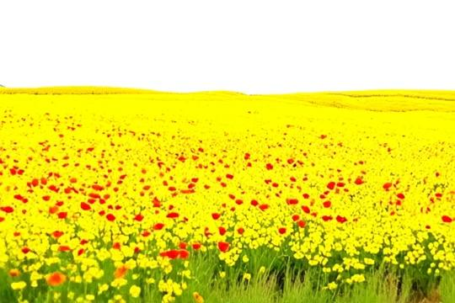
Successfully Generated Scenes:
Scene 1:The Field
A field of bright red poppies and yellow wildflowers swaying gently in a warm breeze.
Camera slowly pushes forward at ground level through the flowers. Clear blue sky, soft golden sunlight, green stems, vibrant colors.
Medium wide shot, slow dolly forward, cheerful spring atmosphere, cinematic

Slide 8
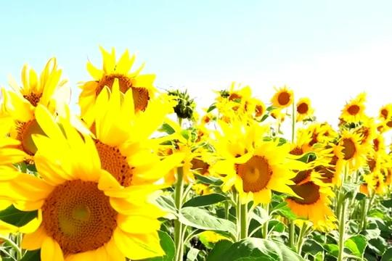
Successfully Generated Scenes:
Scene 2:The Sunflower
A row of tall bright yellow sunflowers slowly swaying in a light breeze against a clear blue sky.
Camera gently pans left to right across the flowers.
Warm afternoon sunlight, petals glowing gold, green leaves.
Medium shot, slow pan, peaceful and warm atmosphere, cinematic.

Slide 9
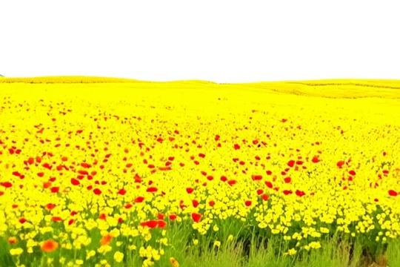
Complete Generated Scenes:
Notes:
Both generated using CogVideoX-2b. The stitch runs live under a second with MoviePy,an open source python library no GPU

